Slide 1
CS 179: GPU Programming
Lecture 4: GPU Memory Systems

Slide 2
Last time
Thread block organization: a grid of blocks of threads
Streaming multiprocessor (SM): CUDA cores and cache
A block is assigned to and executed on a single SM
Warp: A group of up to 32 threads within a block
Threads in a single warp can only run 1 set of instructions at once
Performing different tasks can cause warp divergence and affect performance

Slide 3
This time
Latency and Throughput
GPU Memory Systems

Slide 4
Latency & Throughput
Latency is the delay caused by the physical speed of the hardware
Throughput is the maximum rate of production/processing
CPU = low latency, low throughput
CPU clock = 3 GHz (3 clocks/ns)
CPU main memory latency: ~100+ ns
CPU arithmetic instruction latency: ~1+ ns
GPU = high latency, high throughput
GPU clock = 1 GHz (1 clock/ns)
GPU main memory latency: ~300+ ns
GPU arithmetic instruction latency: ~10+ ns
Above numbers were for Kepler GPUs (e.g. GTX 700 series)
For Fermi, latencies tend to be double that of Kepler GPUs
Notes:
Clock rate – frequency at which the chip Is running (processor’s speed)

Slide 5
Compute & IO Throughput
GeForce GTX Titan Black (GK110 based)
Compute throughput | 5 TFLOPS (single precision)
Global memory bandwidth | 336 GB/s (84 Gfloat/s)
GPU is very IO limited! IO is very often the throughput bottleneck, so its important to be smart about IO.
If you want to get beyond ~900 GFLOPS, need to do multiple FLOPs per shared memory load.
Notes:
TFLOP = Teraflop; a way of measuring the power of a computer based on mathematical capability. (Capability of a processor to calculate one trillion floating-point operations per second)
Memory bandwidth = rate at which data can be read from or stored into a semiconductor memory by a processor
Due to design of GPU, IO (memory access) and compute happen at the same time. IO is generally the bottleneck.
Based on these numbers, will GPUs perform better on algorithms will high computational density or low computational density?
This is why bank conflicts matter.
80% utilization on GPU is great. We’re up to around 93% utilization for single threaded CPU matrix multiplication (probably the most tuned optimized code).

Slide 6
Cache
A cache is a chunk of memory that sits in between a larger pool of memory and the processor
Often times implemented at hardware level
Has much faster access speed than the larger pool of memory
When memory is requested, extra memory near the requested memory is read into a cache
Amount read is cache and memory pool specific
Regions of memory that will always be cached together are called cache lines
This makes future accesses likely to be found in the cache
Such accesses are called cache hits and allow much faster access
If an access is not found in the cache, it's called a cache miss (and there is obviously no performance gain)

Slide 7
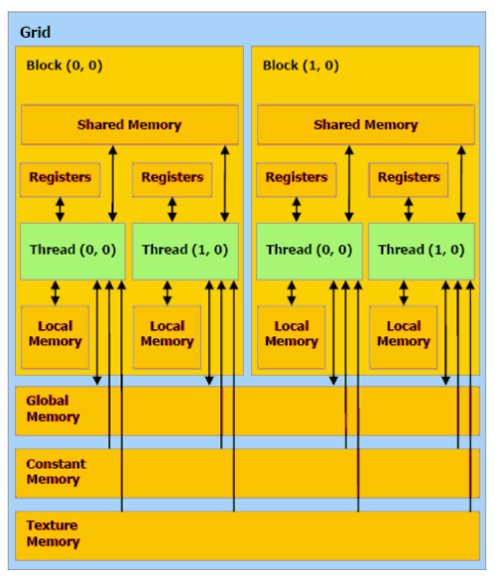
GPU Memory Breakdown
Registers
Local memory
Global memory
Shared memory
L1/L2/L3 cache
Constant memory
Texture memory
Read-only cache (CC 3.5+)
Notes:
Global memory: Slow and uncached, all threads
Texture memory (read only): Cache optimized for 2D access, all threads
Constant memory (read only): Slow, cached, all threads
Shared memory: Fast, bank conflicts; limited; threads in block
Registers: Fast, only for one thread
Local memory: For what doesn’t fit in registers, slow but cached, one thread

Slide 8
Part 1
Registers: The fastest form of memory on the multi-processor. Is only accessible by the thread. Has the lifetime of the thread.
Local memory: Resides in global memory and can be 150x slower than register or shared memory. Is only accessible by the thread. Has the lifetime of the thread.
Shared Memory: Can be as fast as a register when there are no bank conflicts or when reading from the same address. Accessible by any thread of the block from which it was created. Has the lifetime of the block.
Global memory: Potentially 150x slower than register or shared memory -- watch out for uncoalesced reads and writes. Accessible from either the host or device. Has the lifetime of the application—that is, it persistent between kernel launches.

Slide 9
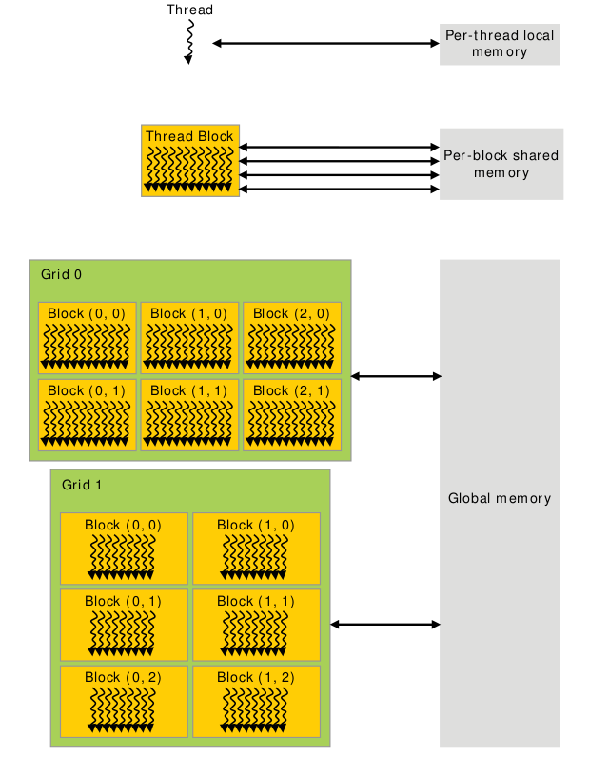
Memory Scope
Notes:
When talking about different memory types, we need to talk about both the scope as well as the hardware implementation.
The scope is simply who can access the memory and what is the lifetime of the memory.
Notably, the hardware implementation can limit the scope (as is the case for local memory), but the scope is often limited beyond what the hardware does.

Slide 10
Global Memory
Global memory is separate hardware from the GPU core (containing SM’s, caches, etc).
The vast majority of memory on a GPU is global memory
If data doesn’t fit into global memory, you are going to have process it in chunks that do fit in global memory.
GPUs have .5 - 24GB of global memory, with most now having ~2GB.
Global memory latency is ~300ns on Kepler and ~600ns on Fermi

Slide 11
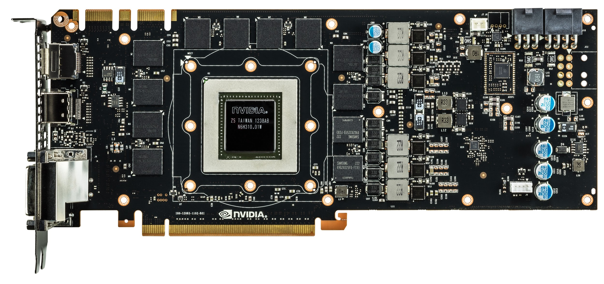
Green box is GK110, red lines are global memory
Nvidia GeForce GTX 780
Notes:
Everything we’ve been talking about is the GPU core. These are made by Nvidia and are the “interesting” part of the GPU.
The global memory is not part of the GPU core, and is in this case manufactured by Samsung. Its RAM similar to what is already in your computer.
Note that not being located on the same silicon generally hurts performance. This is true for accessing global memory from the GPU, and is also (very) true for moving data to GPU over PCI-E.
Light travels about 1 foot each ns (in vacuum).

Slide 12
Accessing global memory efficiently
Global memory IO is the slowest form of IO on GPU
except for accessing host memory (duh...)
Because of this, we want to access global memory as little as possible
Access patterns that play nicely with GPU hardware are called coalesced memory accesses.

Slide 13
Memory Coalescing
Memory accesses are done in large groups setup as Memory Transactions
Done per warp
Fully utilizes the way IO is setup at the hardware level
Coalesced memory accesses minimize the number of cache lines read in through these memory transactions
GPU cache lines are 128 bytes and are aligned
Memory coalescing is much more complicated in reality
See Ch 5 of the textbook for more detail if you're interested but it's not required (will be emailed out to the class late tonight.)
Notes:
Explain what a cache line is from perspective of CPU.
On CPU, 1 load only touches 1 cache line. On GPU, not the case.
Follow with several slides of pictures.

Slide 14
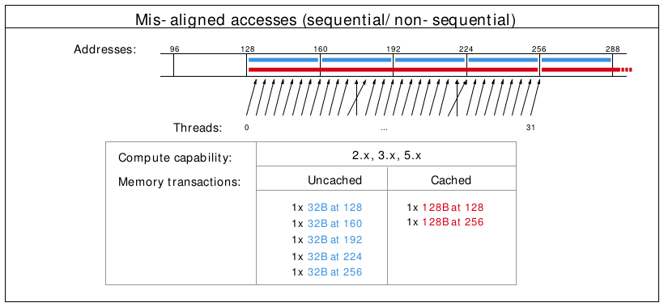
Misalignment can cause non-coalesced access
Notes:
The cross lines don’t matter, but the misalignment causes 2 loads to be done (because first loaded address is 130 rather than 120)

Slide 15
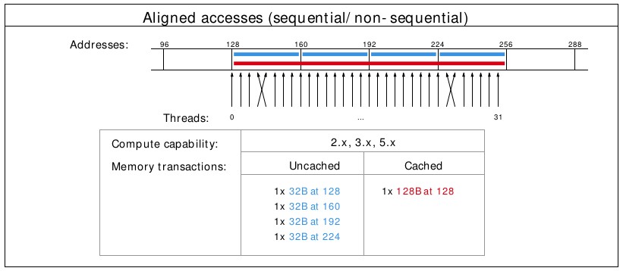
A coalesced access!
Notes:
The cross lines don’t matter, just the total number of cache lines touched.

Slide 16
Shared Memory
Very fast memory located in the SM
Same hardware as L1 cache (will discuss later)
~5ns of latency
Maximum size of ~48KB (varies per GPU)
Scope of shared memory is the block
Remember
SM = streaming multiprocessor
SM ≠ shared memory
Notes:
Nvidia says shared memory latency is “roughly 100x lower”, so probably closer to 3ns, but 5ns is closer enough and easier to think about.
Why is scope of shared memory not global?

Slide 17
Shared memory syntax
Can allocate shared memory statically (size known at compile time) or dynamically (size not known until runtime)
Static allocation syntax:
__shared__ float data[1024];
Declared in the kernel, nothing in host code
Dynamic allocation syntax
Host:
kernel<<<grid_dim, block_dim, numBytesShMem>>>(args);
Device (in kernel):
extern __shared__ float s[];
For multiple dynamically sized variables, see this blog post
Little bit more complicated and there are easy alternatives

Slide 18
A shared memory application
Task: Compute byte frequency counts
Input: array of bytes of length n
Output: 256 element array of integers containing number of
occurrences of each byte
Naive: build output in global memory, n global stores
Smart: build output in shared memory, copy to global memory at end, 256 global stores
Notes:
You could declare byte frequency counts as a “stack” variable (local) and hope L1 cache does a good job.
For algorithms where you iteratively build output, you often want to do this in shared memory.

Slide 19
Computational Intensity
Computational intensity is a representation of how many operations must be done on a single data point (FLOPs / IO)
Vaguely similar to the big O notation in concept and usage
e.x.
Matrix multiplication: n³ / n² = n
n-body simulation: n² / n = n
If computational intensity is > 1, then same data used in more than 1 computation
Do as few global loads and as many shared loads as possible
Notes:
FLOP = floating point operations
IO = IO operations
blocking algorithms for matrix multiplication

Slide 20
A common pattern in kernels
copy from global memory to shared memory
__syncthreads()
perform computation, incrementally storing output in shared memory, __syncthreads() as necessary
copy output from shared memory to output array in global memory
Notes:
syncthreads works at block scope, synchronizes all warps in the block.
question: is __syncthreads needed to synchronize within a warp?
answer: not always, called warp synchronous coding. more about synchronization on friday

Slide 21
Bank Conflicts
Shared memory is setup as 32 banks
If you divide the shared memory into 4 byte-long elements, element i lies in bank i % 32.
A bank conflict occurs when 2 threads in a warp access different elements in the same bank.
Bank conflicts cause serial memory accesses rather than parallel
Serial anything in GPU programming = bad for performance

Slide 22
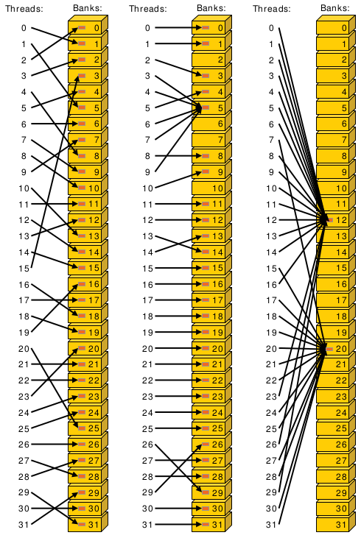
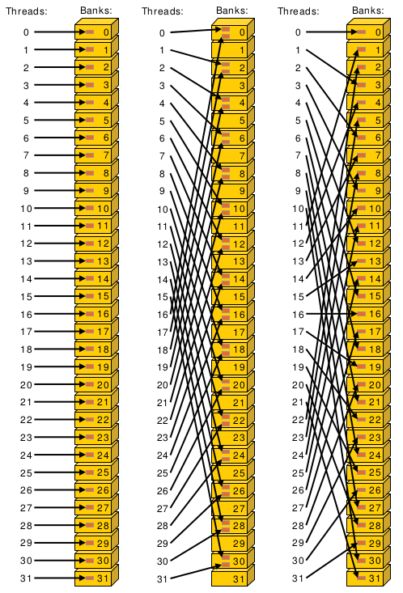
Bank conflict examples
Notes:
Center example would take roughly twice as long.
Bank conflicts might not seem like a huge deal (because access with 2-way bank conflict is same latency as arithmetic instruction) but can have significant effect on already partially tuned programs.

Slide 23
Bank conflicts and strides
Stride is the distance from thread i access to thread i + 1 access
Stride 1 ⇒ 32 x 1-way “bank conflicts” (so conflict-free)
Stride 2 ⇒ 16 x 2-way bank conflicts
Stride 3 ⇒ 32 x 1-way “bank conflicts” (so conflict-free)
Stride 4 ⇒ 8 x 4-way bank conflicts
…
Stride 32 ⇒ 1 x 32-way bank conflict :(
Notes:
Stride is distance from thread i access to thread i+1 access.
How many unique banks are accessed, and how many threads are accessing that bank

Slide 24
Padding to avoid bank conflicts
To fix the stride 32 case, we’ll waste a byte on padding and make the stride 33 :)
Don’t store any data in slots 32, 65, 98, ....
Now we have
thread 0 ⇒ index 0 (bank 0)
thread 1 ⇒ index 33 (bank 1)
thread i ⇒ index 33 * i (bank i)
Notes:
Note padding is wasting some very precious hardware, and also makes code uglier.

Slide 25
Registers
A Register is a piece of memory used directly by the processor
Fastest “memory” possible, about 10x faster than shared memory
There are tens of thousands of registers in each SM
Generally works out to a maximum of 32 or 64 32-bit registers per thread
Most stack variables declared in kernels are stored in registers
example: float x; (duh...)
Statically indexed arrays stored on the stack are sometimes put in registers
Notes:
Need to check assembly to see what is in registers.
Arrays must be statically indexed because instructions hard code register number.

Slide 26
Local Memory
Local memory is everything on the stack that can’t fit in registers
The scope of local memory is just the thread.
Local memory is stored in global memory
much slower than registers
Notes:
What’s the downside of storing local memory in global memory?
So how can we avoid storing anything in local memory?
Answer: use less local variables than registers
yes, but we’ve seen that using more local variables can help performance (assuming the local variables in registers)
sounds like we want to have as many variables that we can put in registers and no more!
If we have more local variables then registers, then some local variables will be spilled to local/global memory. This is called register spilling and kills performance.

Slide 27
Register spilling example
x0 = x[0];
y0 = y[0];
x1 = x[1];
y1 = y[1];
z0 = x0 + y0;
z1 = x1 + y1;
When we have enough registers, this code does 4 loads from local memory and 0 stores.
Now assume we only have 3 free registers before any of this code is executed (but don’t worry about z0 and z1)

Slide 28
Register spilling example
x0 = x[0];
y0 = y[0];
x1 = x[1];
y1 = y[1];
z0 = x0 + y0;
z1 = x1 + y1;
starting with only 3 free registers...
Register spilling cost:
1 extra load
1 extra store
2 extra pairs of consecutive
dependent instructions
cannot load y[1] until we free a register. store x1 to make space.
Now we need to load x1 again.
Notes:
Stores also have instruction dependencies (cannot use a register until the store from it is done).
The pairs of dependent instructions are the store x1, load y[1] (because we’re loading y1 into the same register that we’re storing from) and load x1, z1 = x1 + y1
There are worse spilling scenarios (what if x0 was stored?) and also better (just don’t load y1 until after computing z0), but its difficult for compiler to find optimal instruction ordering wrt spilling and dependencies.
A form of register allocation problem can be reduced to k-coloring a graph, which is NP-complete.
So, is register spilling (and any use of local memory) truly so bad for performance? Thankfully not (in small doses), due to the L1 cache.

Slide 29
Questions?
Global memory
Local memory
Shared memory
Registers
Notes:
Give brief explanation of each type of memory.
I’ll go over the most important types of memory first.

Slide 30
Part 2
L1/L2/L3 cache
Constant memory
Texture memory
read-only cache (CC 3.5)
Notes:
Give brief explanation of each type of memory.
I’ll go over the most important types of memory first.

Slide 31
L1 Cache
Fermi - caches local & global memory
Kepler, Maxwell - only caches local memory
same hardware as shared memory
Nvidia used to allow a configurable size (16, 32, 48KB), but dropped that in recent generations
each SM has its own L1 cache
Notes:
There are PTX instructions to load global memory to indicate whether you want to put it in L1 cache.
Recommendation: Use shared memory for whatever you can think of using it for, then make the rest of the space L1.
Makes local memory much cheaper (as register spills now go into L1 which is about as fast as shared).
so a little register spilling can be OK sometimes
L1 actually merged with texture cache in Maxwell.

Slide 32
L2 cache
caches all global & local memory accesses
~1MB in size
shared by all SM’s
Notes:
can look at L1/L2 hit/miss rates in profiler to see if local memory use is problematic

Slide 33
L3 Cache
Another level of cache above L2 cache
Slightly slower (increased latency) than L2 cache but also larger.

Slide 34
Constant Memory
Constant memory is global memory with a special cache
Used for constants that cannot be compiled into program
Constants must be set from host before running kernel.
~64KB for user, ~64KB for compiler
kernel arguments are passed through constant memory

Slide 35
Constant Cache
8KB cache on each SM specially designed to broadcast a single memory address to all threads in a warp (called static indexing)
Can also load any statically indexed data through constant cache using “load uniform” (LDU) instruction
Go to http://www.nvidia.com/object/sc10_cuda_tutorial.html for more details
Notes:
in this context, static does not mean known at compile time, it means all threads accessing the same same address.
Memory address cannot depend on threadId.
Cache is small/cheap because no writeback mechanism required.
Compiler uses LDU sometimes (const + pointer aliasing concerns)

Slide 36
Constant memory syntax
In global scope (outside of kernel, at top level of program):
__constant__ int foo[1024];
In host code:
cudaMemcpyToSymbol(foo, h_src, sizeof(int) * 1024);

Slide 37
Texture Memory
Complicated and only marginally useful for general purpose computation
Useful characteristics:
2D or 3D data locality for caching purposes through “CUDA arrays”. Goes into special texture cache.
fast interpolation on 1D, 2D, or 3D array
converting integers to “unitized” floating point numbers
Use cases:
Read input data through texture cache and CUDA array to take advantage of spatial caching. This is the most common use case.
Take advantage of numerical texture capabilities.
Interaction with OpenGL and general computer graphics
Notes:
for general purpose computing “texture support could not have been justified if the hardware hadn’t already been there” - cuda handbook
I’ve never used textures personally, and they are the most foreign part of CUDA to me.
CUDA arrays use trick like a space filling curve

Slide 38
Texture Memory
And that’s all we’re going to say on texture memory.
It’s a complex topic, you can learn everything you want to know about it from the textbook
Notes:
complex and not super useful in my opinion

Slide 39
Read-Only Cache (CC 3.5+)
Many CUDA programs don’t use textures, but we should take advantage of the texture cache hardware.
CC ≥ 3.5 makes it much easier to use texture cache.
Many const restrict variables will automatically load through texture cache (also called read-only cache).
Can also force loading through cache with __ldg intrinsic function
Differs from constant memory because doesn’t require static indexing

Slide 40
Questions?
Registers
Global memory
Local memory
Shared memory
L1/L2/L3 cache
Constant memory
Texture memory
Read-only cache (CC 3.5)
Notes:
Give brief explanation of each type of memory.
I’ll go over the most important types of memory first.

Slide 41
Next time....
Next lecture will be the last lecture focused on basic GPU knowledge
Few more optimization techniques
Synchronization
Will discuss GPU specific algorithms starting next week

